Slide 1
Content Monetization Modeler – YouTube Ad Revenue Prediction
-By
Silviya X

Slide 2
Problem Statement
Content creators and businesses generate large amounts of video performance data, but understanding how views, likes, comments, watch time, and other factors impact advertising revenue can be challenging. This project uses machine learning to predict YouTube ad revenue from video performance and contextual data, helping identify key factors that influence content monetization.
Objectives
Analyze and preprocess YouTube video data.
Create meaningful engagement and watch-time features.
Build and compare regression models.
Select the best model using R², RMSE, MAE.
Develop a Streamlit app for revenue prediction.
Provide visual analytics and business insights.

Slide 3
Technology Stack
• Python • Pandas (Data Processing) • NumPy • Scikit-learn (Machine Learning) • Matplotlib (Visualization) • Streamlit (Web Application) • Joblib (Model Deployment) • Google Colab
Dataset Description
• Domain: Social Media Analytics / Content Monetization • Platform: YouTube • Records: 120,000+ • Target Variable: ad_revenue_usd • Features: Views, Likes, Comments, Watch Time, Subscribers, Category, Device, Country, etc.

Slide 4
Project Workflow
Data Collection
↓
Data Cleaning & Preprocessing
↓
Exploratory Data Analysis (EDA)
↓
Feature Engineering
↓
Feature Encoding & Scaling
↓
Train-Test Split
↓
Regression Model Building
↓
Model Comparison & Evaluation
↓
Lasso Model Selection
↓
Feature Importance Analysis
↓
Model Deployment using Streamlit
↓
Revenue Prediction & Business Insights

Slide 5
Data Cleaning
Checked missing values
Checked duplicate records
Corrected data types
Identified numerical and categorical features
Handled data quality issues
Prepared the dataset for machine learning
Feature Engineering
Engagement Rate
Like Rate
Comment Rate
Watch Time per View
Average Watch Time
Watch Time Ratio
Date - based features (Year, Month, Day of Week, Quarter)

Slide 6
Train-Test Split
The dataset was divided into two parts:
Training Data (80%) – Used to train the regression models.
Testing Data (20%) – Used to evaluate how well the trained models perform on unseen data.
Train Multiple Regression Models
Linear Regression
Ridge Regression
Lasso Regression
Random Forest
Gradient Boosting
Model Evaluation
The regression models were evaluated using three metrics:
R² Score – Measures how well the model explains the variation in revenue. Higher is better.
RMSE – Measures the average prediction error, giving more weight to larger errors. Lower is better.
MAE – Measures the average absolute difference between actual and predicted revenue. Lower is better.

Slide 7
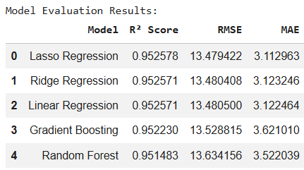
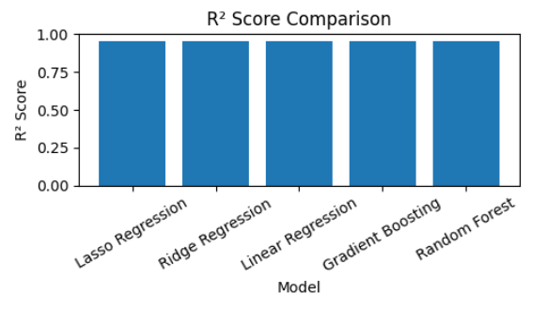
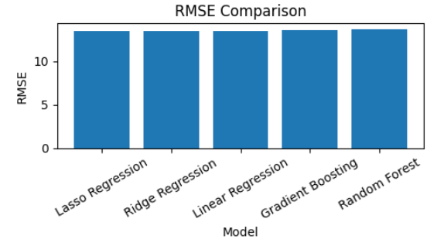
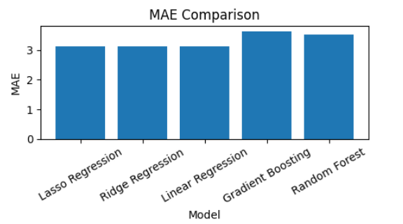
Model Evaluation Results

Slide 8
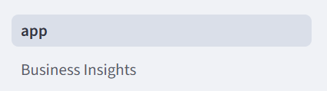
Lasso Feature Analysis
Key Insight
Watch Time was the most influential feature, followed by Likes, Comments, and Views, indicating that viewer engagement and retention play an important role in content monetization.
Streamlit Application
Page 1: Revenue Prediction
Page 2: Business Insights
Key Features | Coefficient
Watch Time | 59.604
Likes | 8.652
Comments | 2.126
Views | 0.661

Slide 9
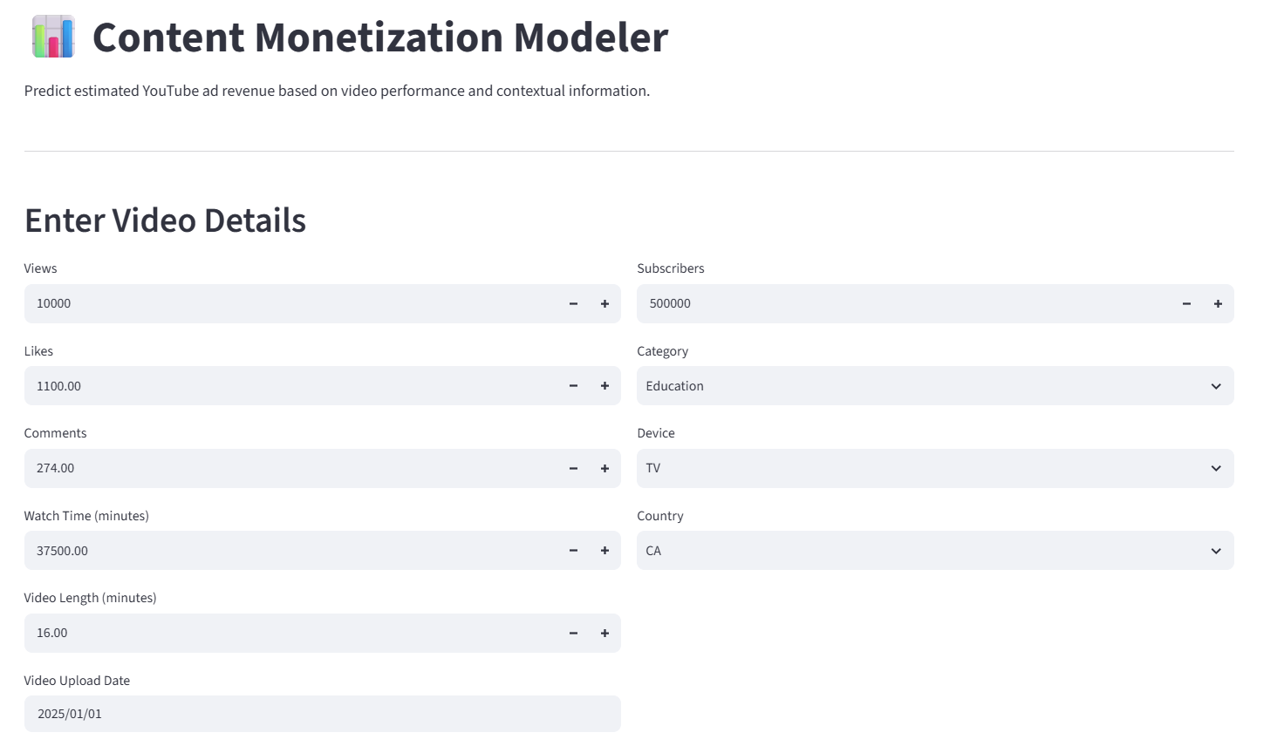
Page 1: Revenue Prediction

Slide 10
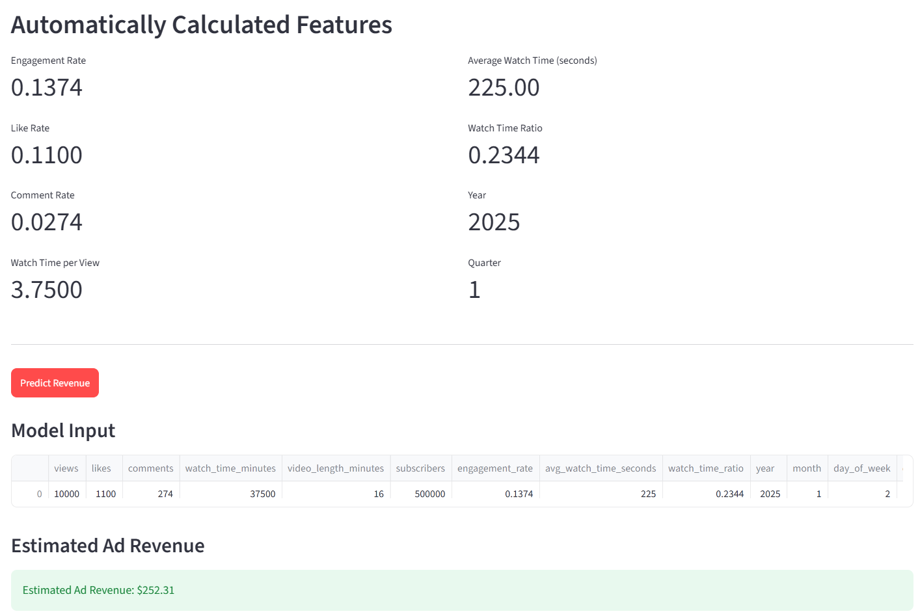

Slide 11
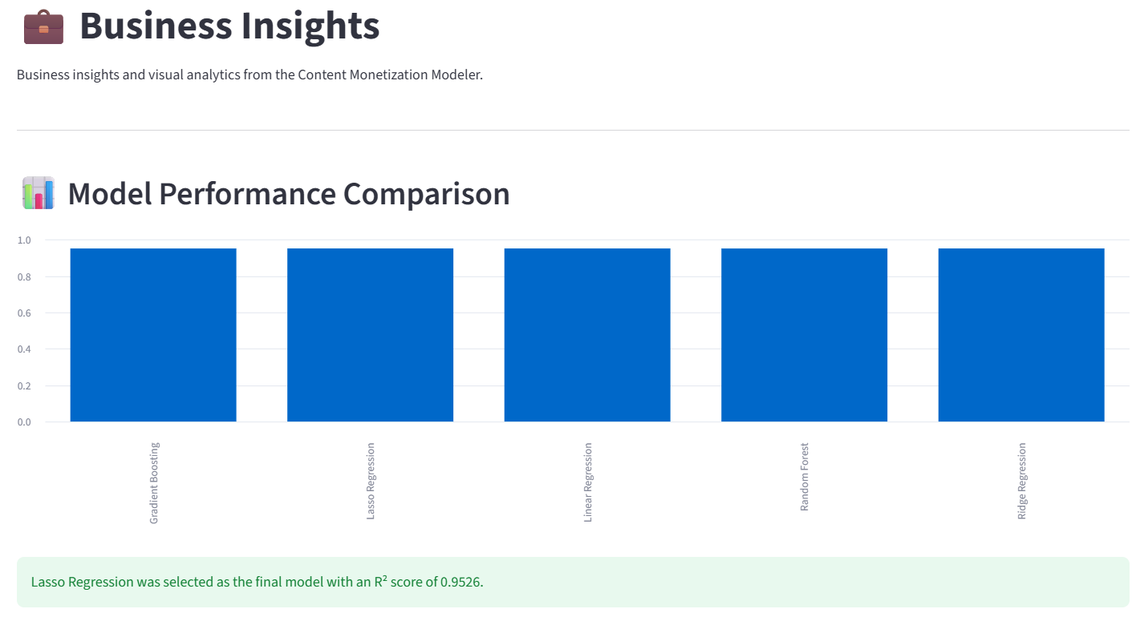
Page 2: Business Insights

Slide 12
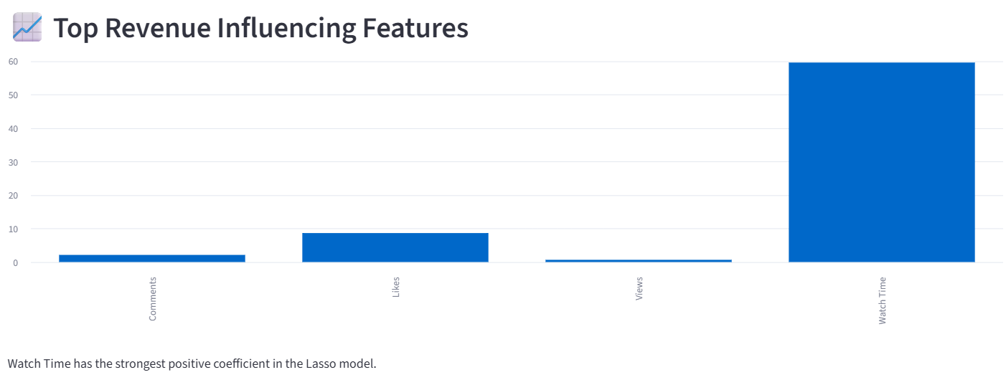
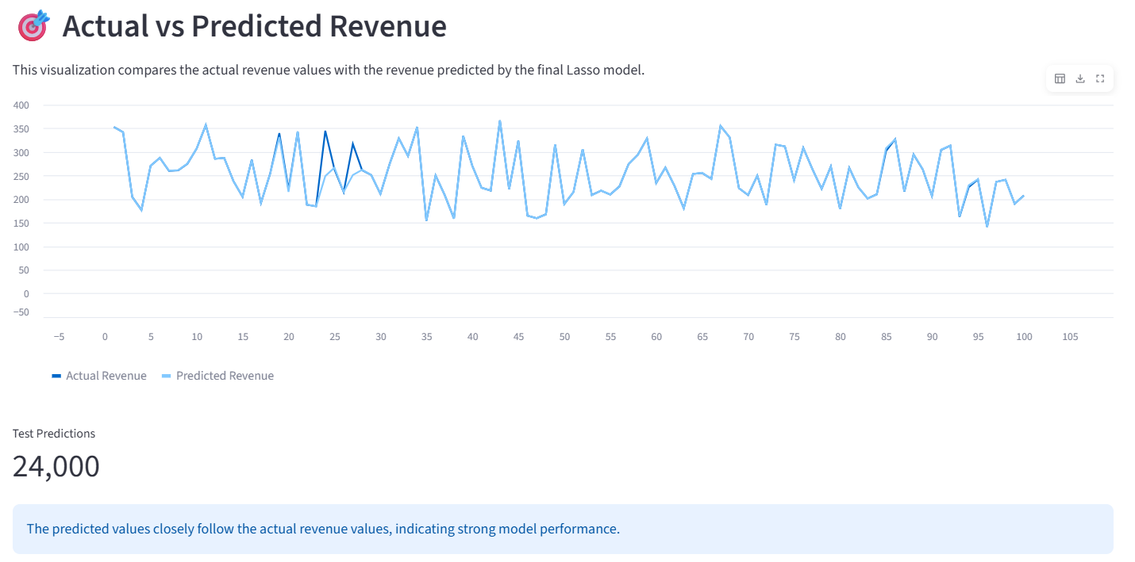

Slide 13
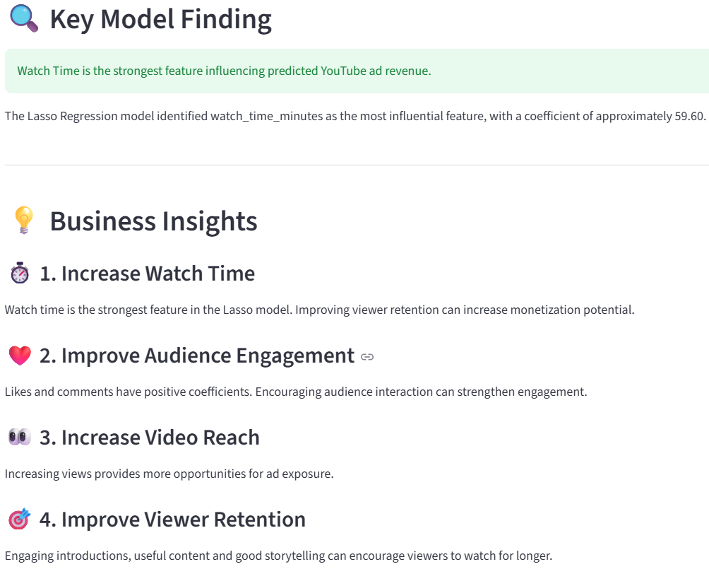

Slide 14
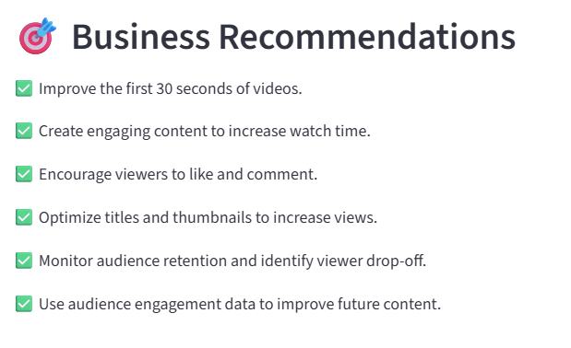

Slide 15
Business Insights
The analysis provides the following key insights:
Watch time is the strongest revenue-influencing feature in the final Lasso model.
Likes have a positive relationship with predicted revenue.
Comments also contribute positively to predicted revenue.
Views have a positive contribution to the model.
Audience engagement and viewer retention are important factors for content monetization.
Improving watch time can be an important strategy for increasing monetization potential.

Slide 16
Conclusion
Successfully developed an end-to-end YouTube Ad Revenue Prediction model.
Compared five regression models using R², RMSE, and MAE.
Lasso Regression achieved the best overall performance with an R² of 0.9526.
Lasso analysis identified Watch Time, Likes, Comments, and Views as key revenue-influencing features.
Developed a two-page Streamlit application for revenue prediction and business insights.
The project demonstrates how machine learning can support data-driven content monetization decisions.
Thank You!

